Slide 1

Speech Emotion Recognition using Machine Learning
AI Development Program
Technion – Israel Institute of Technology
Netanel Mazuz • Yzhar Goldstein • Victor Melichov

Slide 2
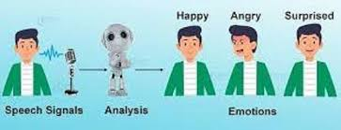

The Problem
Motivation:
As human beings speech is amongst the most natural way to express ourselves. We depend so much on it that we recognize its importance when resorting to other communication forms like emails and text messages where we often use emojis to express the emotions associated with the messages. As emotions play a vital role in communication, the detection and analysis of the same is of vital importance in today’s digital world of remote communication.
Problem:
Most humans have the natural abilities to recognize emotions from speech, but the problem is that in today’s digital world we need computers to do that job for us for many reasons. Human machine interaction is widely used nowadays in many applications. One of the medium of interaction is speech. Emotion can play an important role in decision making. If emotion can be recognized properly from speech then system can act accordingly.

Slide 3





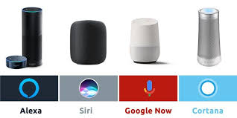


Applications
Customers satisfaction in Call Centers
Job satisfaction in Businesses and Corporations
Suicide prevention in social media and violence detection
Voice and Mental assistance

Slide 4
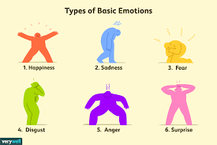
Solution and Target
Our mission is to find out a classic machine learning classifier model to recognize the emotion type from audio speech sample (except NN)
Recognition of basic emotion types for general purposes:
Neutral, Happy, Sad, Fear, Disgust, Angry, Surprise
We want to achieve as much highest Score as possible for each of type
We need to find a Dataset that has all of these emotion types in as many variations as possible, with different gender, pitch, accent, age, sentences and clarity
Our expectation target, is comparable to a referenced best projects in Kaggle:
Project | Model | Score
Kaggle project 1 | Neural Network | ~95%
Kaggle project 2 | SVM | ~61%
Our project target | Logistic Regression | 70-80%

Slide 5
Data info
 | RAVDESS | TESS | CREMA-D | SAVEE
Actors | 12 Male, 12 Female | 2 Female | 48 Male, 43 Female | 4 Males
Ages | Unspecified | 26, 64 | 20-74 | 27-31
Lexical statements | 2 | 200 | 12 | 15
Accent | Neutral North American | Unspecified | African America, Asian, Caucasian, Hispanic, Unspecified | English
Emotion types | neutral, calm, happy, sad, angry, fearful, surprise, disgust | anger, disgust, fear, happiness, pleasant surprise, sadness, neutral | Anger, Disgust, Fear, Happy, Neutral, Sad | anger, disgust, fear, happiness, sadness surprise, neutral
Emotion intensity | normal, strong | Unspecified | Low, Medium, High, Unspecified | Unspecified
Total samples | 1440 | 2800 | 74420 | 480

Slide 6
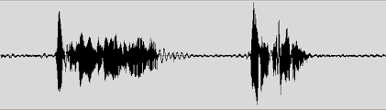
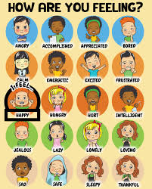
System Block Diagram
Speech Audio Dataset
Training Samples
Test Samples
Pre-processing
Pre-processing
Augmentation
Features Extraction
Features Extraction
Training Classifier Model
Model Prediction
Emotion Recognition

Slide 7
Speech Analysis

Slide 8
Audio Feature Extraction - intoduction

Slide 9
Feature Extraction

Slide 10
MiniRocket

Slide 11
Feature Analysis

Slide 12
Feature Selection

Slide 13
Model GridSearch

Slide 14
Conclusion

Slide 15
Further work

Slide 16
Add Title

